Slide 1
Creating a Cube from the Maximum Miniatures Manufacturing Data Mart This Tutorial is based on the Learn By Doing Exercises in Chapter 9 of Brian Larson’s Book: Delivering Business Intelligence with Microsoft SQL Server 2012, 3rd edition.

Slide 2
The Purpose of this Tutorial
To create an OLAP Cube from the MaxMinManufacturingDM Datamart.
Note:
An OLAP cube is a multidimensional Business Intelligence (BI) Semantic model. With an OLAP cube, we can perform multidimensional analysis on the information in the MaxMinManufacturingDM datamart.

Slide 3
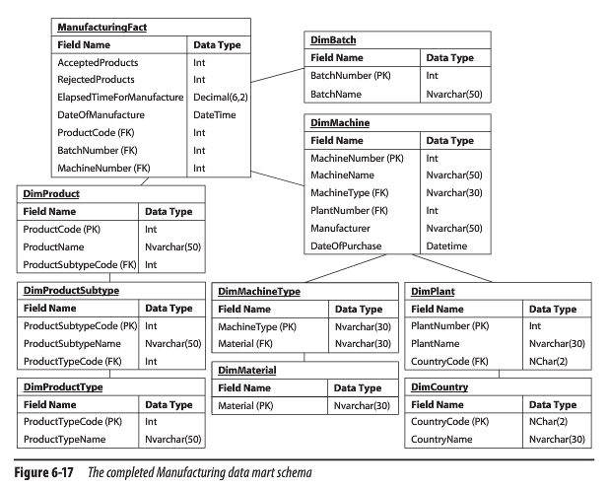
MaxMinManufacturingDM Data Mart Schema

Slide 4
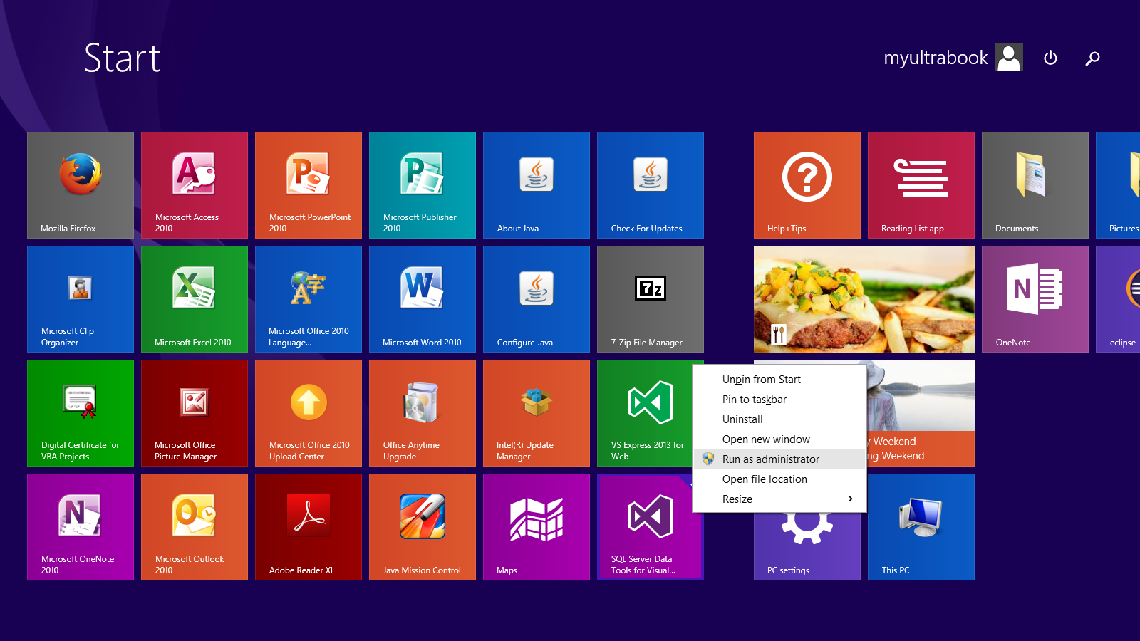
Run the SQL Server Data Tools as Administrator
1. Right-click the SQL Server Data Tools icon.
2. Select Run as administrator

Slide 5
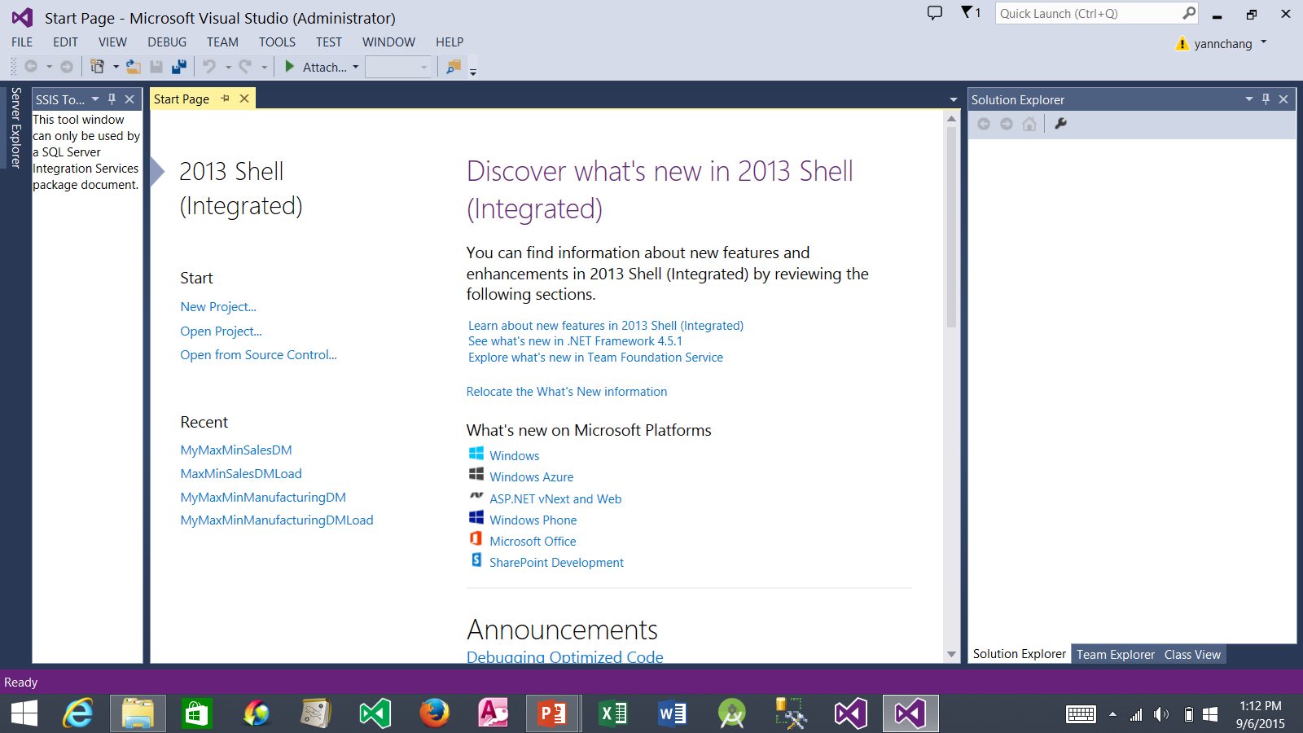
Create a New Project
1. Click New Project…

Slide 6
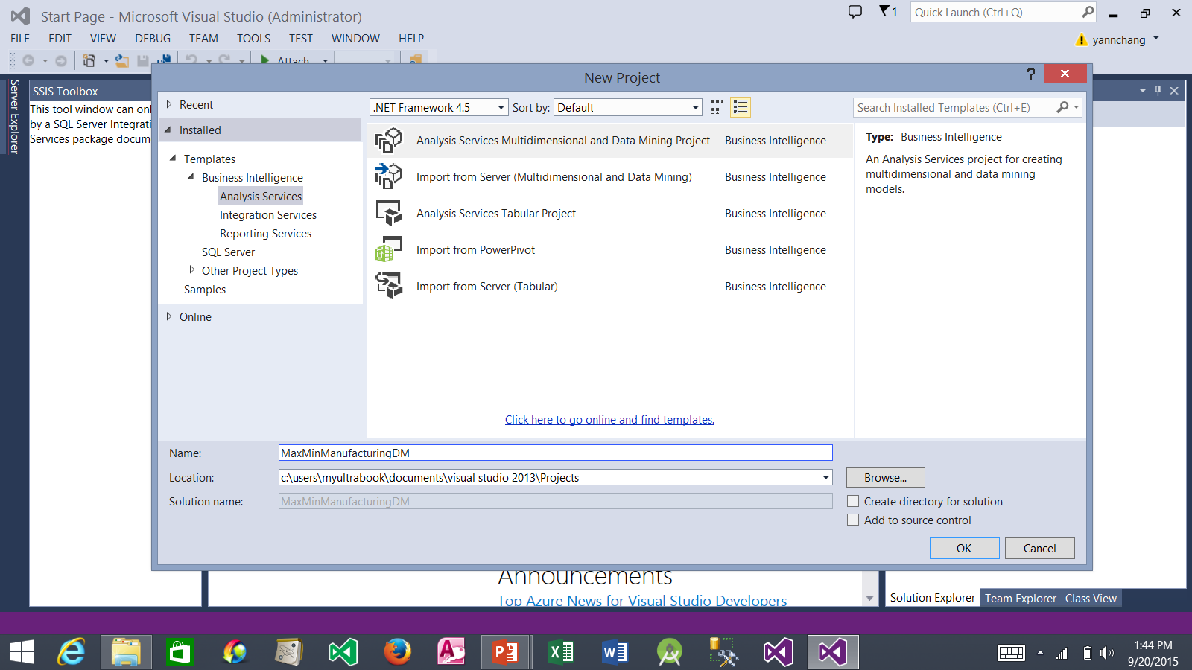
Create a New Project (continued)
2. Select this option.
1. Select Analysis Services.
3. Enter MaxMinManufacturingDM.
4. Click the OK button.

Slide 7
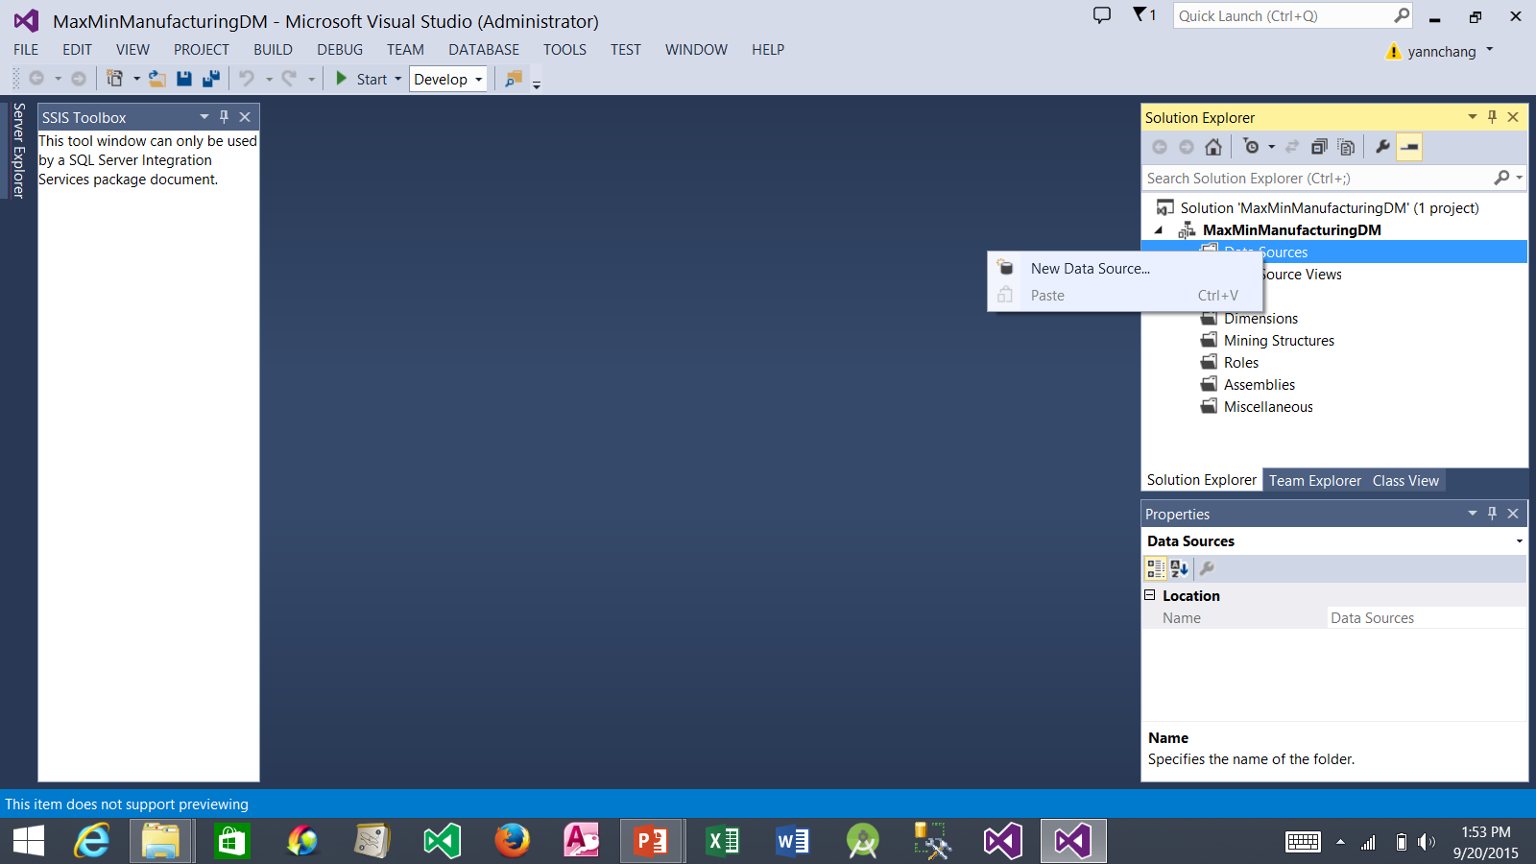
Create a New Data Source
1. Right-click Data Sources folder and select New Data Source…

Slide 8
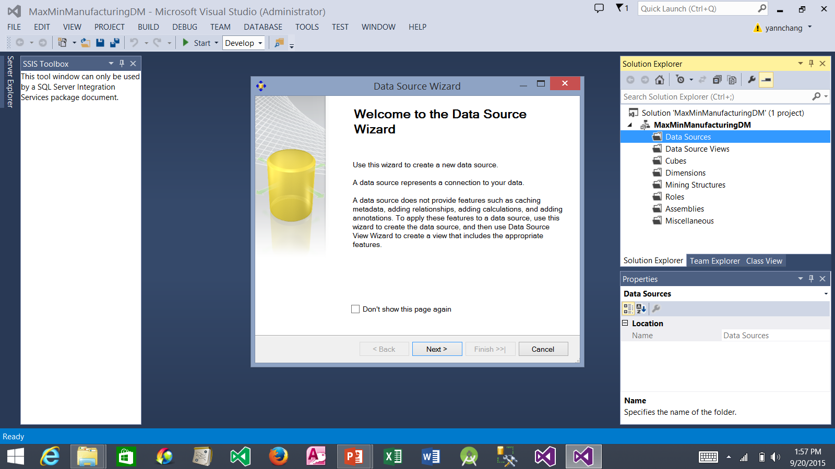
Create a New Data Source (continued)
1. Click the Next button.

Slide 9
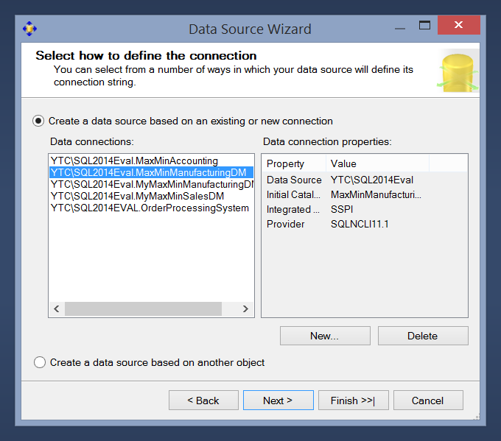
Create a New Data Source (continued)
1. Select the MaxMinManufacturingDM connection that you created in the previous Tutorial.
2. Click the Next button.

Slide 10
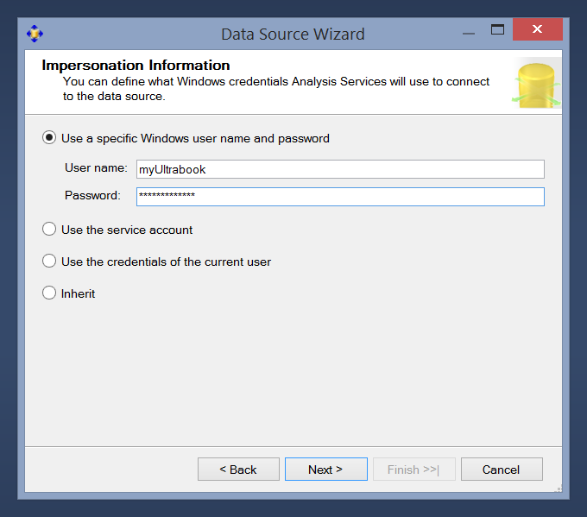
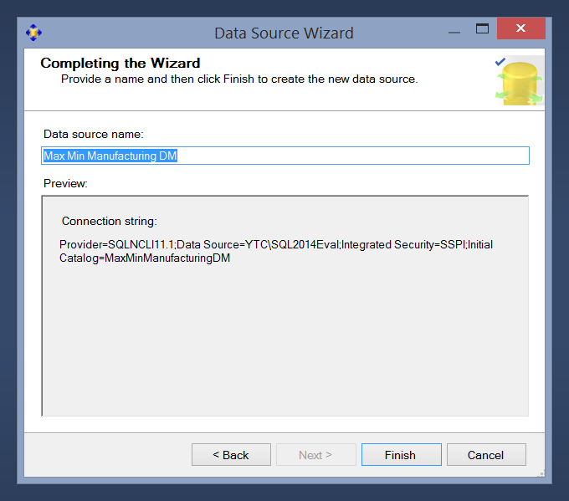
Create a New Data Source (continued)
3. Use this name. Note: you may keep the spaces in the Data Source name.
1. Enter your Windows system credentials: username and password.
2. Click the Next button.
4. Click the Finish button.

Slide 11
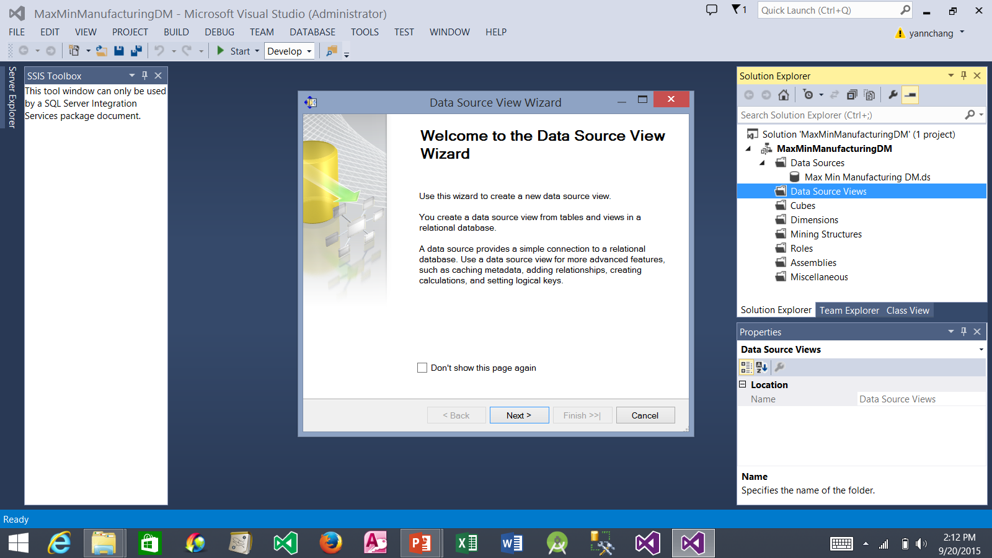
Create a New Data Source View
2. The Wizard window appears.
1. Right-click the Data Source Views folder and then select New Data Source View…
3. Click the Next button.

Slide 12
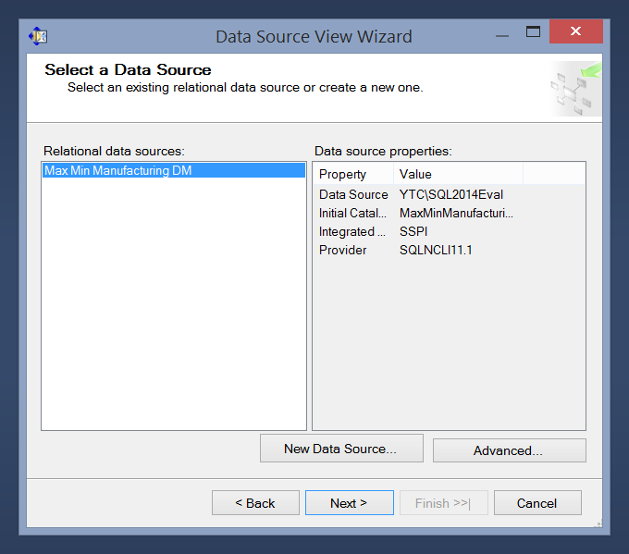
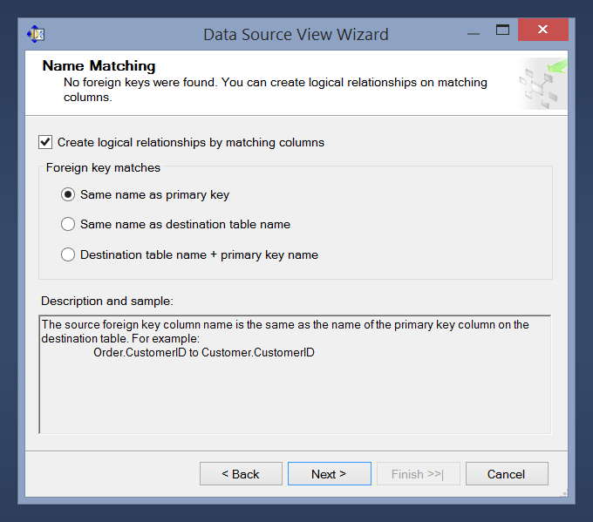
Create a New Data Source View (continued)
3. Be sure to check these two options.
1. Select the Max Min Manufacturing DM data source that you defined earlier.
2. Click the Next button.
4. Click the Next button.

Slide 13
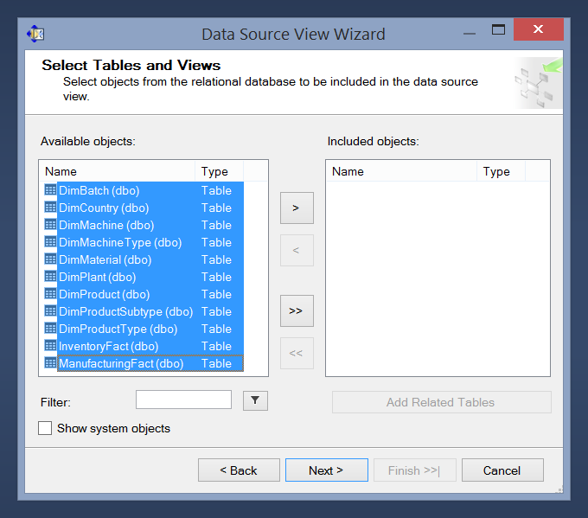
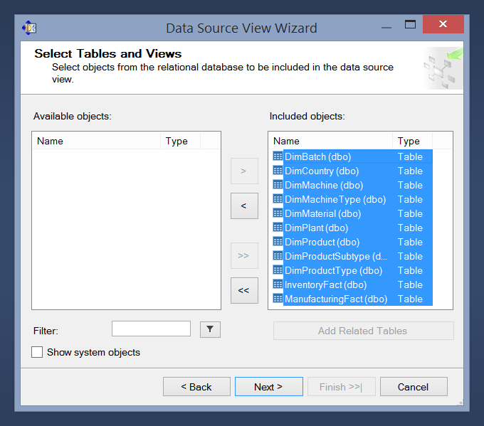
Create a New Data Source View (continued)
3. All objects should be moved here.
1. Select all objects
2. Click this button.
4. Click the Next button.

Slide 14
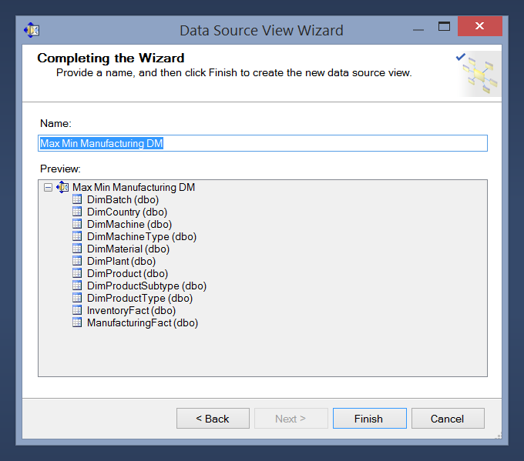
Create a New Data Source View (continued)
1. Be sure to enter name as shown.
2. Click the Finish button.

Slide 15
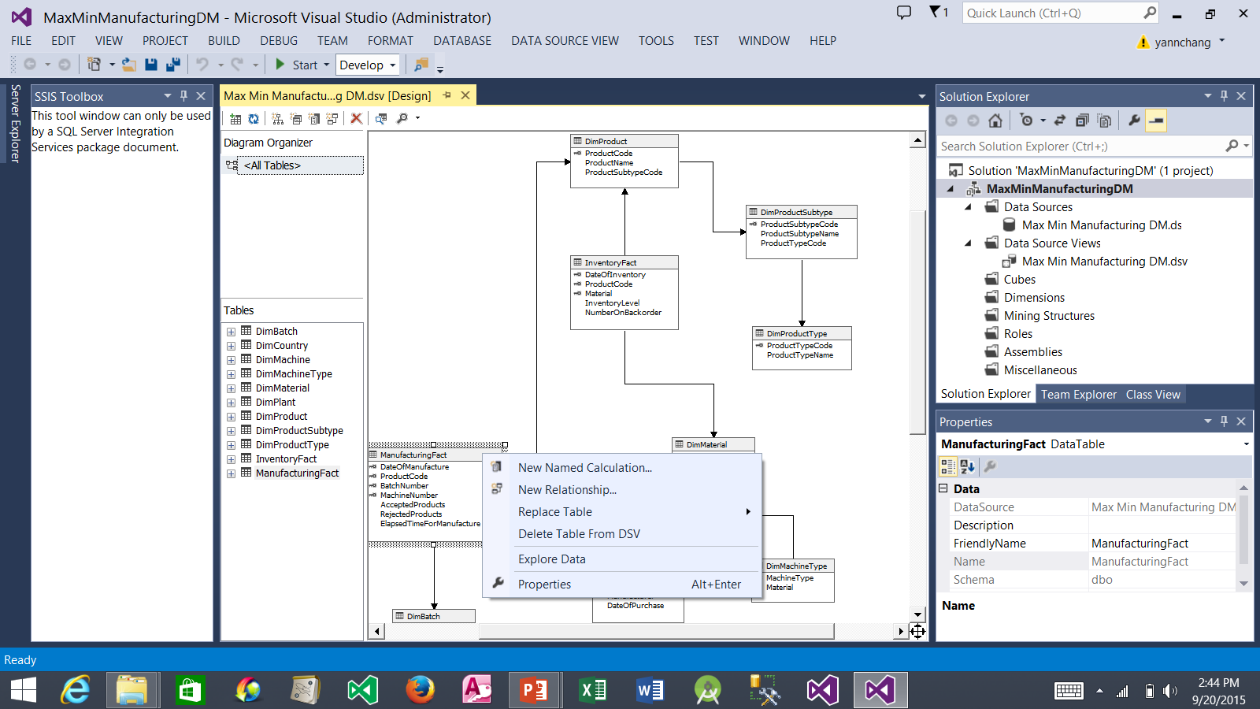
Add 3 New Named Calculations in the ManufacturingFact Table
1. The Data Source View Design tab appears.
2. Right-click the title bar of the ManufacturingFact table and select New Named Calculation…

Slide 16
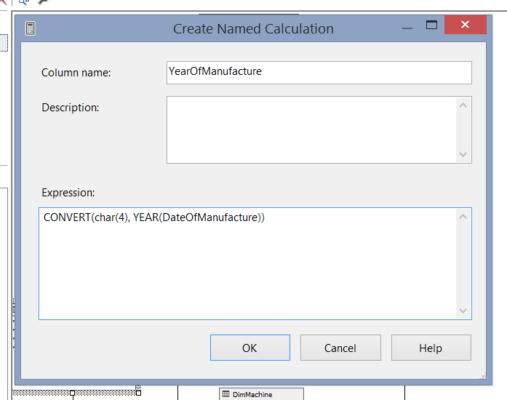
Add 3 New Named Calculations in the ManufacturingFact Table (cont.)
1. Type a column name as shown.
2. Enter an expression as shown.
3. Click the OK button.

Slide 17
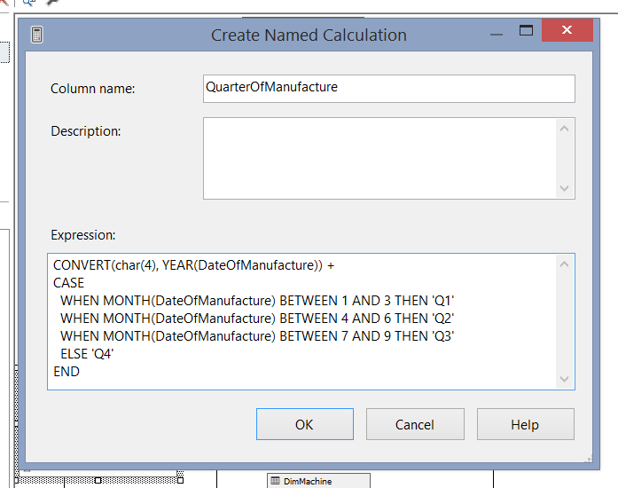
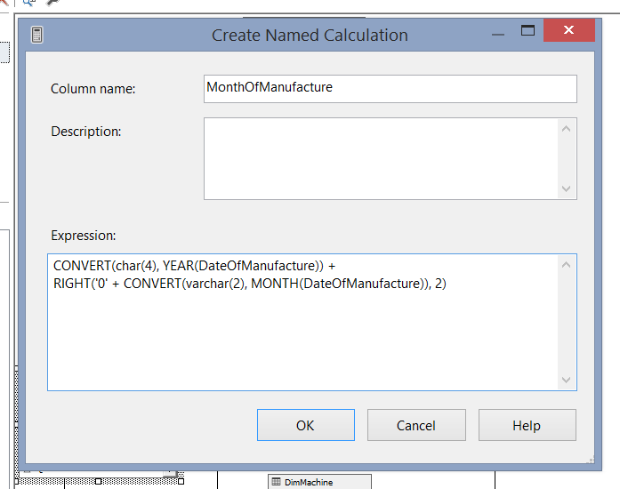
Add 3 New Named Calculations in the ManufacturingFact Table (cont.)
6. Type a column name as shown.
2. Type a column name as shown.
1. Create another named calculation (see Slide 15)
5. Create another named calculation (see Slide 15)
3. Enter an expression as shown.
7. Enter an expression as shown.
8. Click the OK button.
4. Click the OK button.

Slide 18
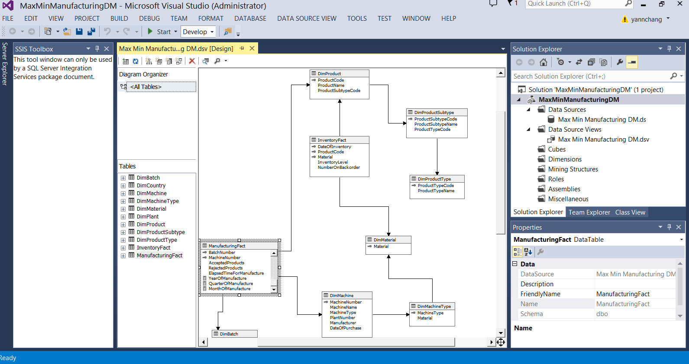
Add 3 New Named Calculation in the InventoryFact Table
2. Similarly, create YearOfInventory, QuarteOfInventory, and MonthOfInventory named calculations in the InventoryFact table. Use the same expressions, replacing DateOfManufacture with DateOfInventory.
1. Three columns should be added to the ManufacturingFact table: YearOfManufacture, QuarterOfManufacture, and MonthOfManufacture

Slide 19
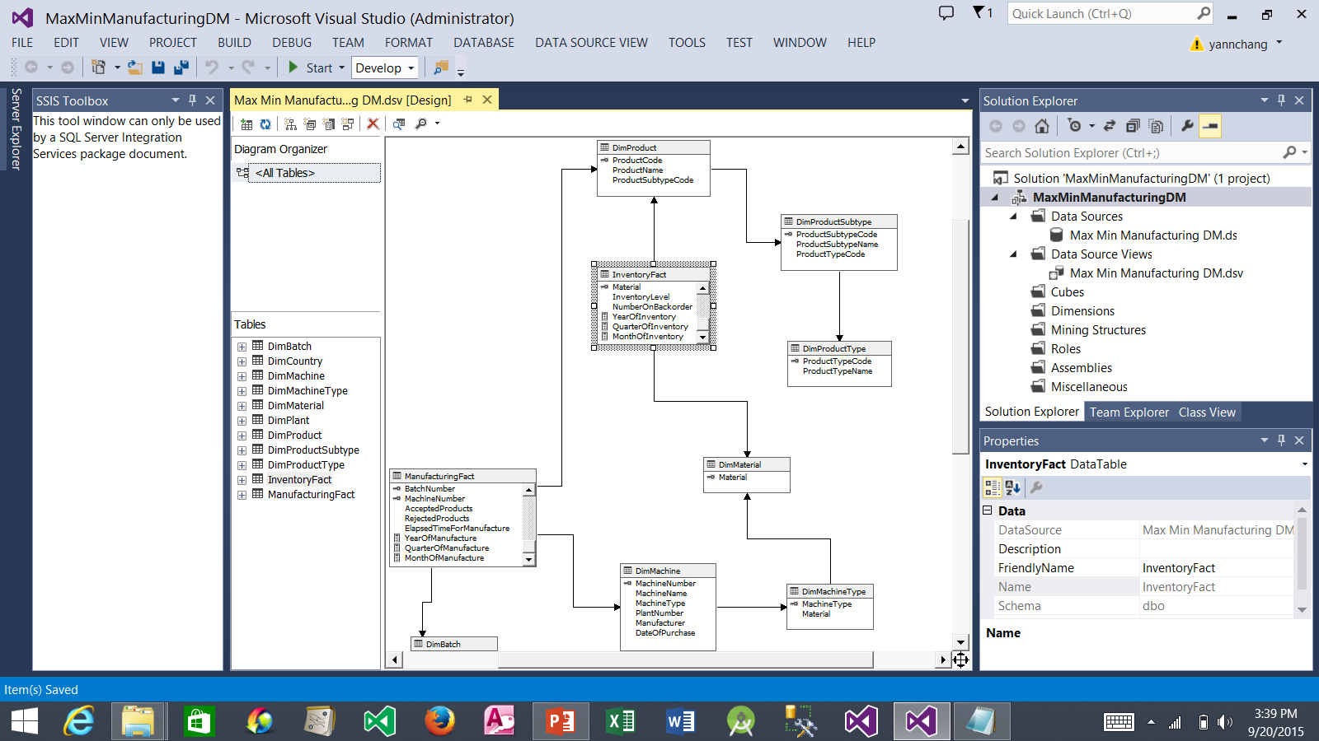
Add a New Cube
1. Three columns should be added to the InventoryFact table: YearOfInventory, QuarterOfInventory, and MonthOfInventory.
2. Right-click the Cubes folder and select New Cube.

Slide 20
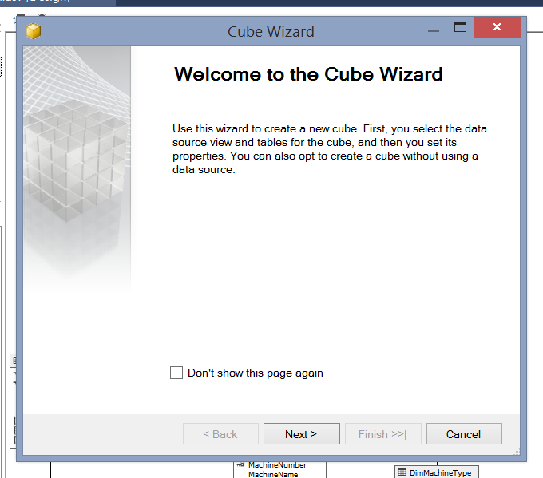
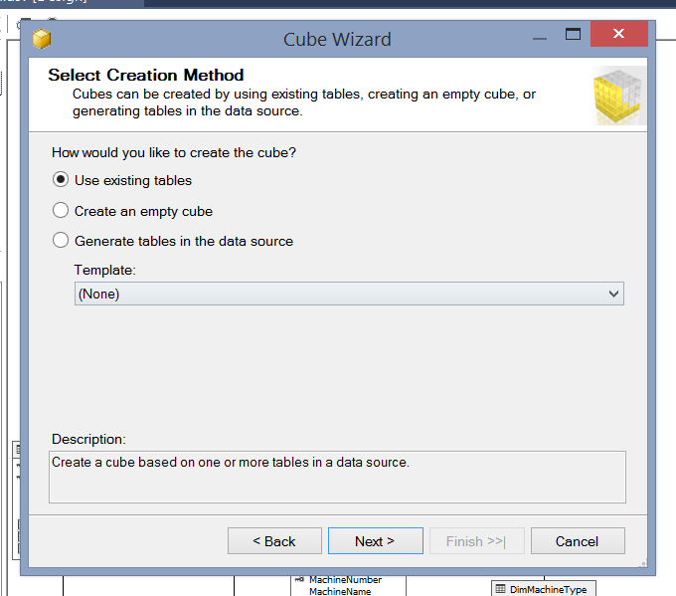
Add a New Cube (continued)
2. Be sure to check this option.
3. Click the Next button.
1. Click the Next button.

Slide 21
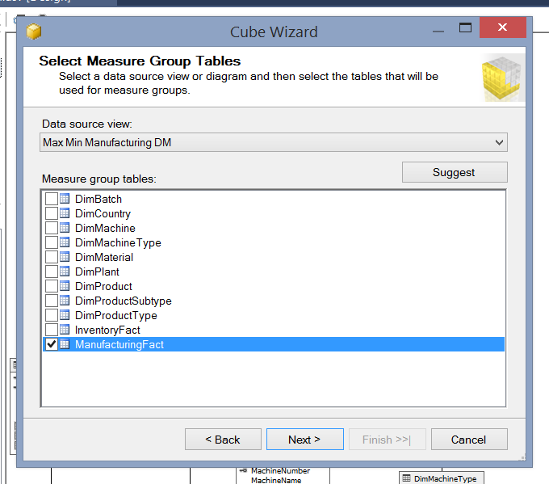
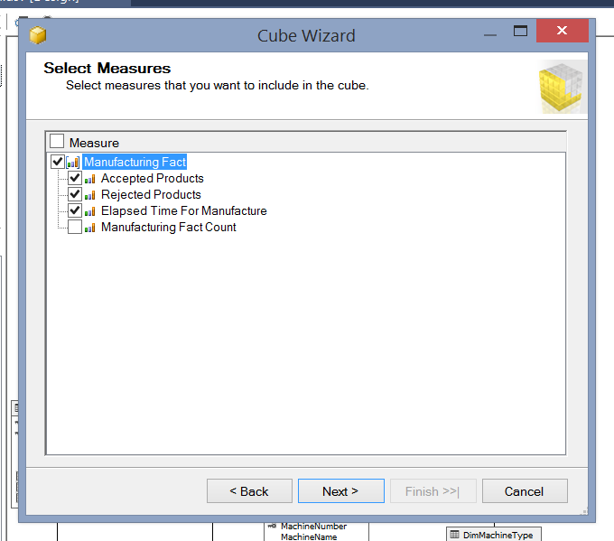
Add a New Cube (continued)
1. For now, check the ManufacturingFact table. We will add the InventoryFact table later.
3. We are not going to use the Manufacturing Fact count. Uncheck it.
2. Click the Next button.
4. Click the Next button.

Slide 22
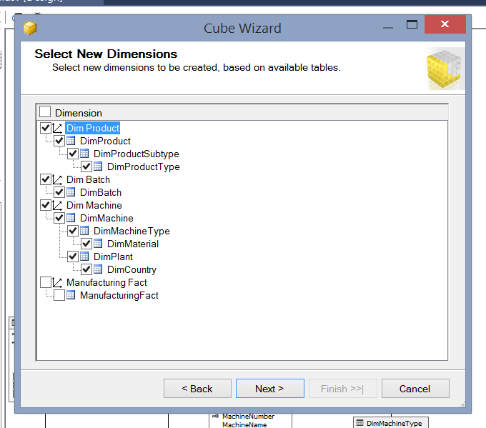
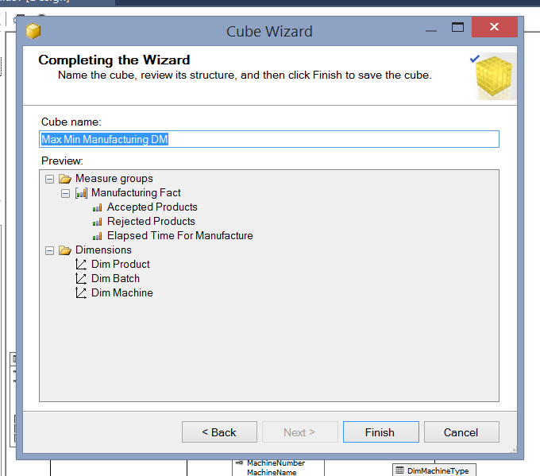
Add a New Cube (continued)
3. If cube name is empty, enter the name as shown, including spaces.
1. Be sure to uncheck both Manufacturing Fact options – ManufacturingFact table is not a dimension table.
4. Click the Finish button.
2. Click the Next button.

Slide 23
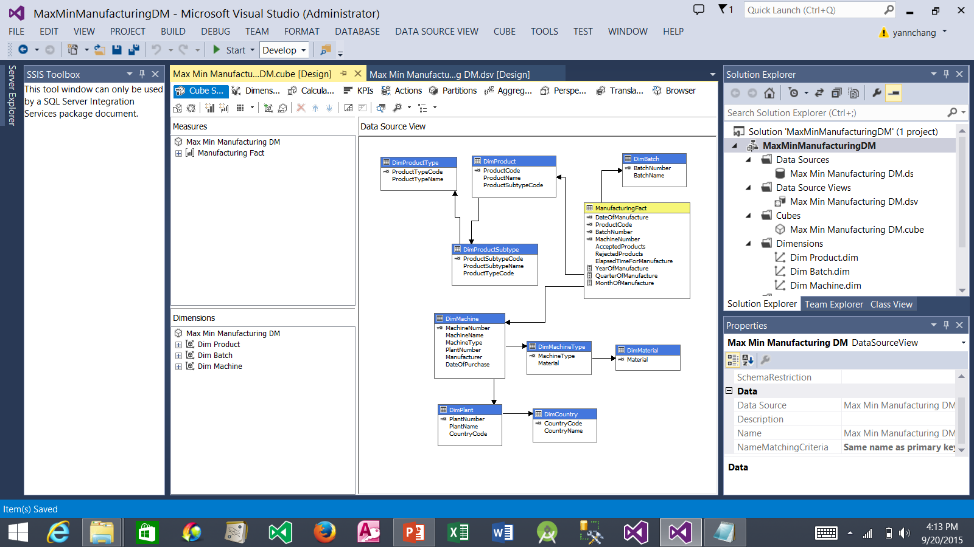
Add a New Cube (continued)
1. After arranging the view, the Data Source View should appear similar to this view.
3. Click the Save All button.
2. Notice that the wizard did not create time dimension for us. We will manually create the time dimension later.

Slide 24
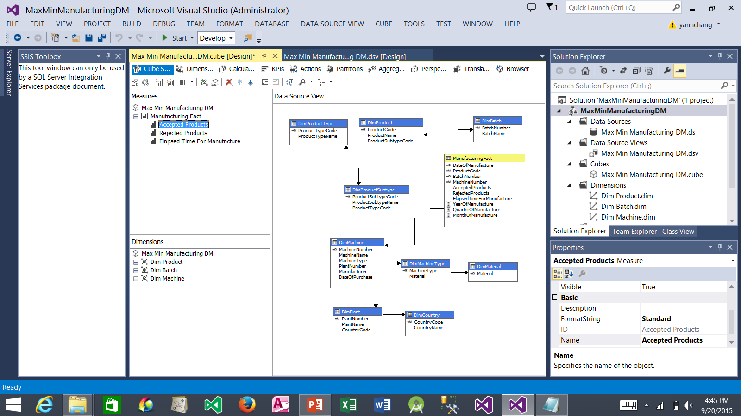
Working with Measures and Measure Groups
2. Select Accepted Products measure.
1. Click this node to expand the ManufacturingFact measure group.
4. Repeat Steps 2 and 3 for Rejected Products and Elapsed Time for Manufacture measures.
3. Select Standard.

Slide 25
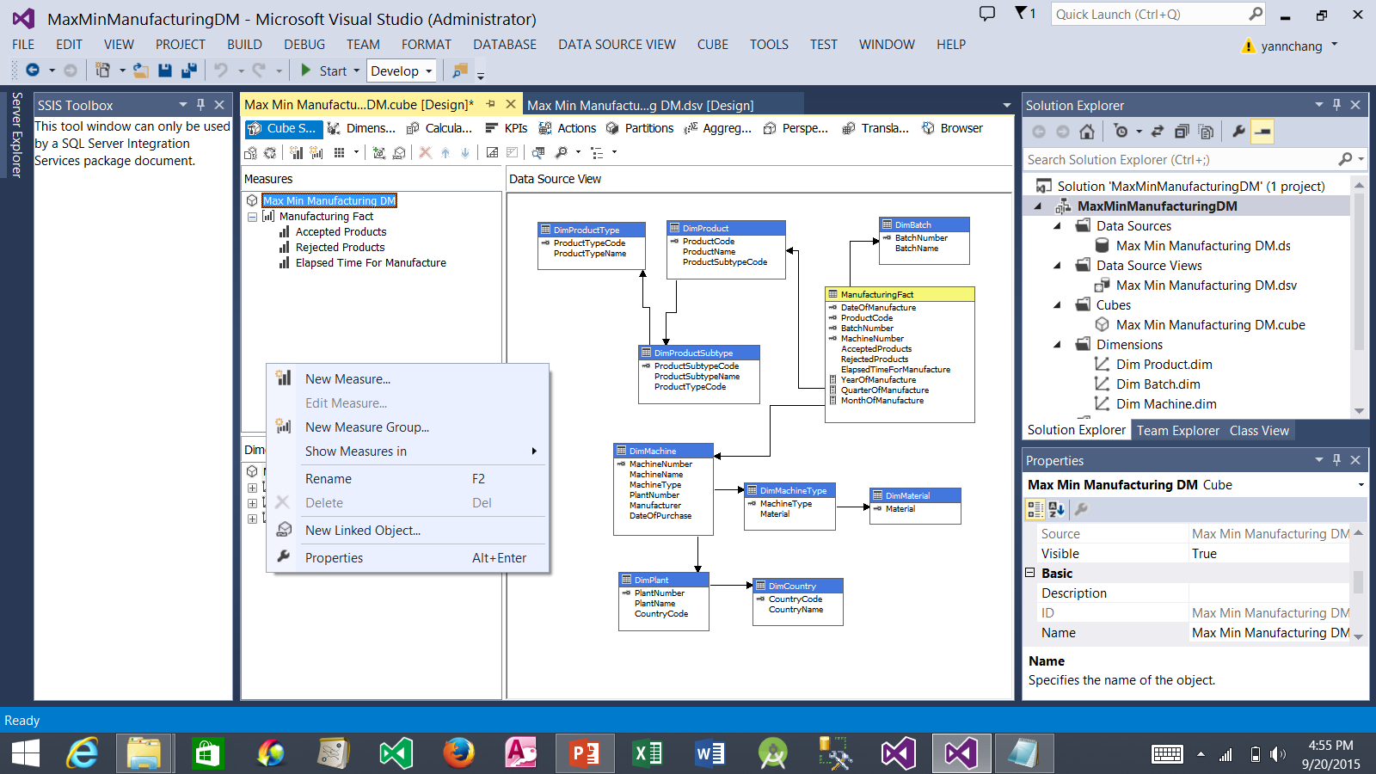
Working with Measures and Measure Groups (cont.)
1. Right-click in an empty space inside the Measures window and select New Measure Group…

Slide 26
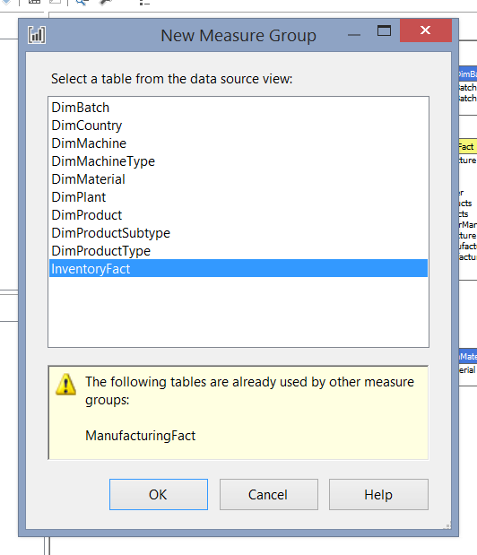
Working with Measures and Measure Groups (cont.)
1. Select the InventoryFact table.
2. Click the OK button.

Slide 27
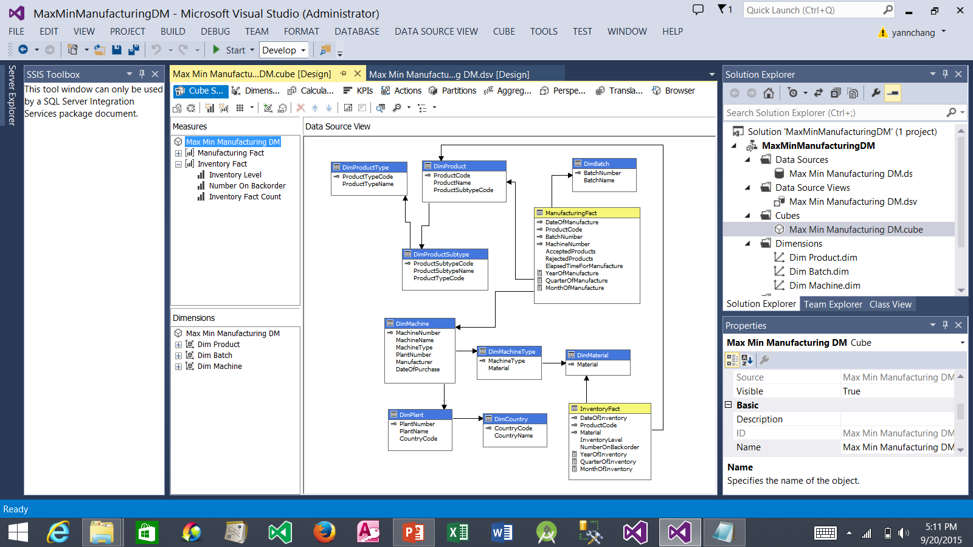
Working with Measures and Measure Groups (cont.)
2. Click this node to expand the Inventory Fact measure group.
1. The InventoryFact table is added to the cube. After arranging the tables, the cube’s Data Source View should be similar to this view.

Slide 28
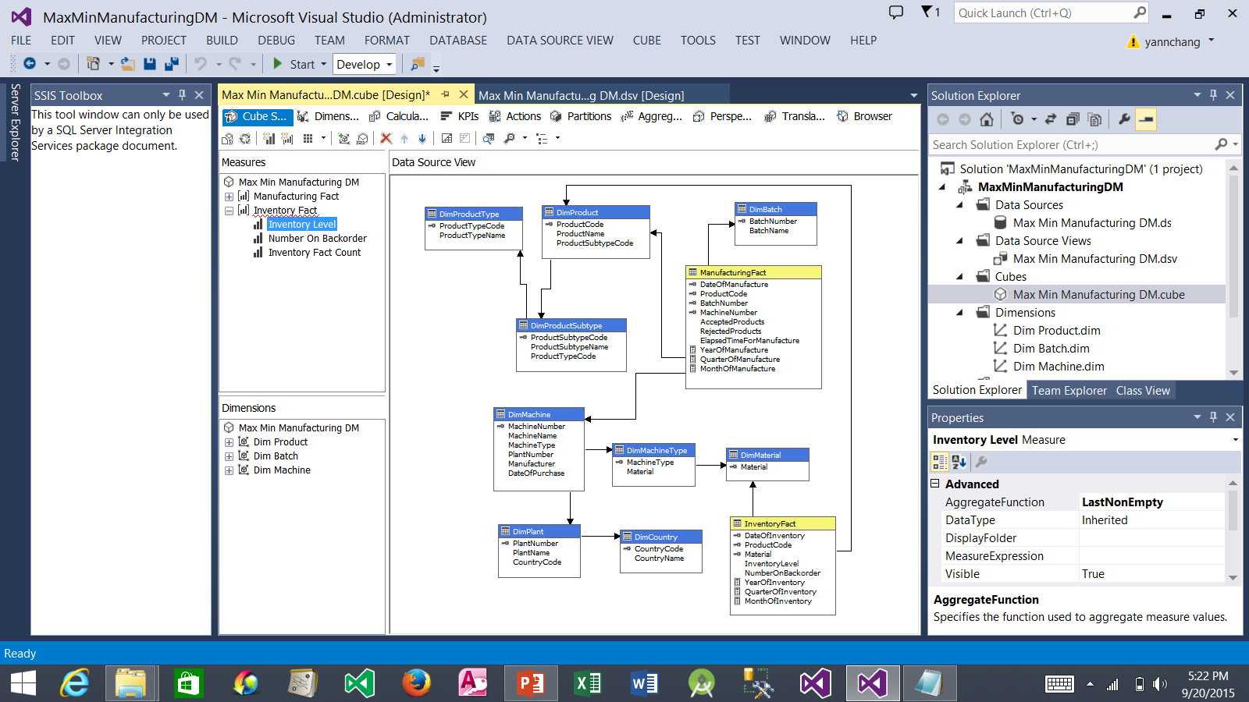
Working with Measures and Measure Groups (cont.)
1. Select the Inventory Level measure. We will take care of the wavy red line later.
3. Scroll down until you see the FormatString property. Select Standard option from the drop-down list.
2. Select LastNonEmpty option from the drop-down list.
4. Repeat Steps 1, 2, and 3 for the Number On Backorder measure.
5. Right-click on the Inventory Fact Count. Select Delete from the context window. Click the OK button to confirm the deletion.

Slide 29
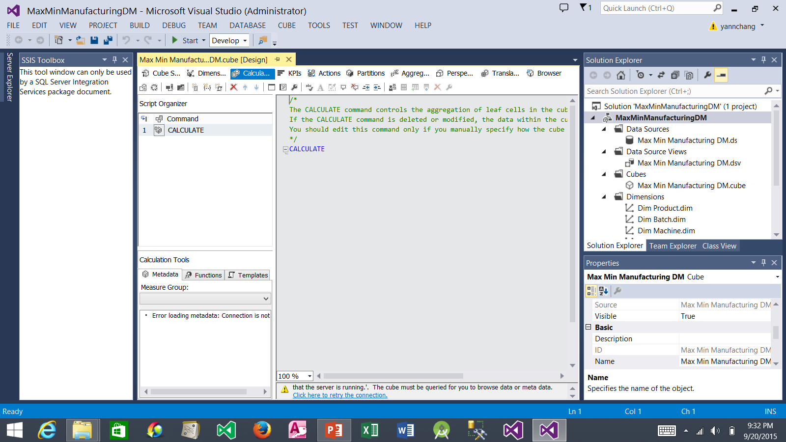
Working with Measures and Measure Groups (cont.)
1. Click the Calculation tab. Note: at this point, you might get an error message. Simply dismiss the error dialog box. It should not affect the end results.
2. Click the New Calculated Member button.

Slide 30
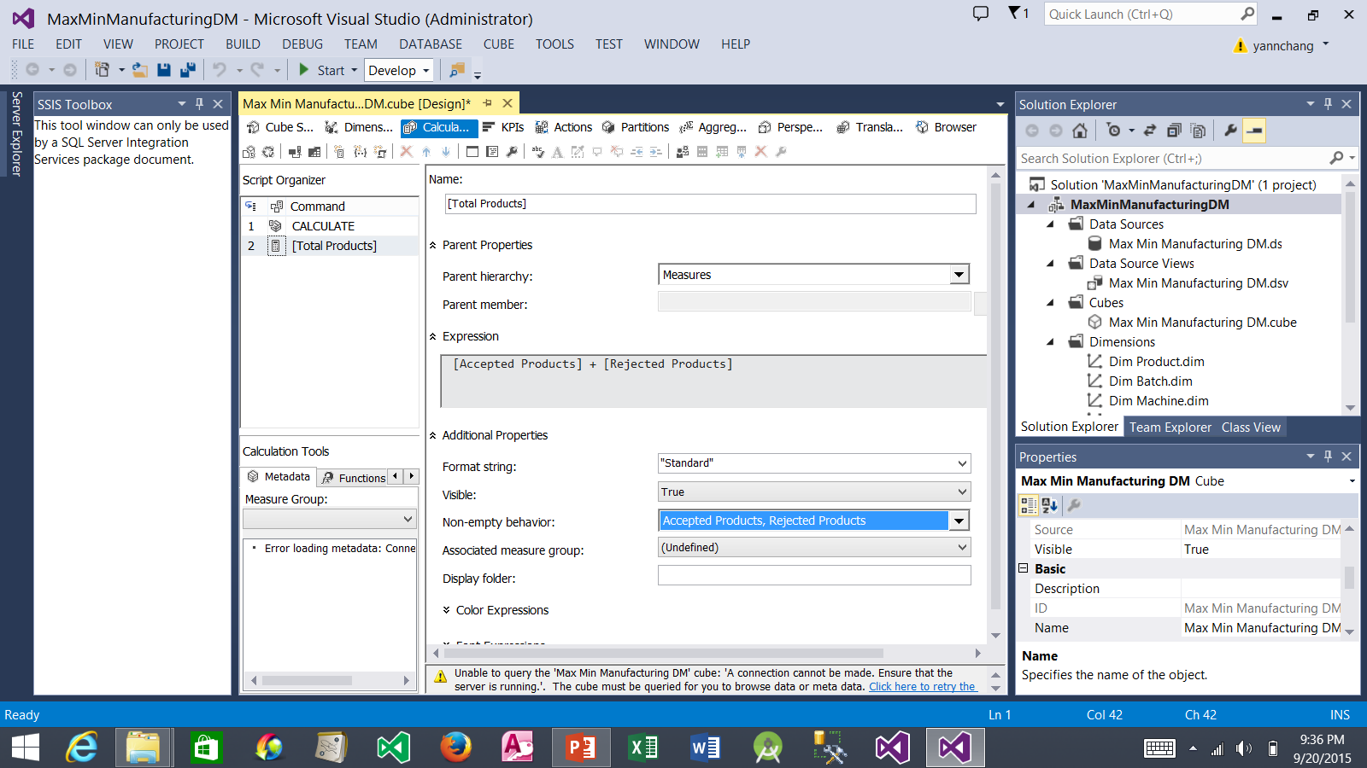
Working with Measures and Measure Groups (cont.)
1. Type as shown here.
2. Type as shown here.
4. Click this drop-down list and check Accepted Products and Rejected Products options.
3. Select Standard.

Slide 31
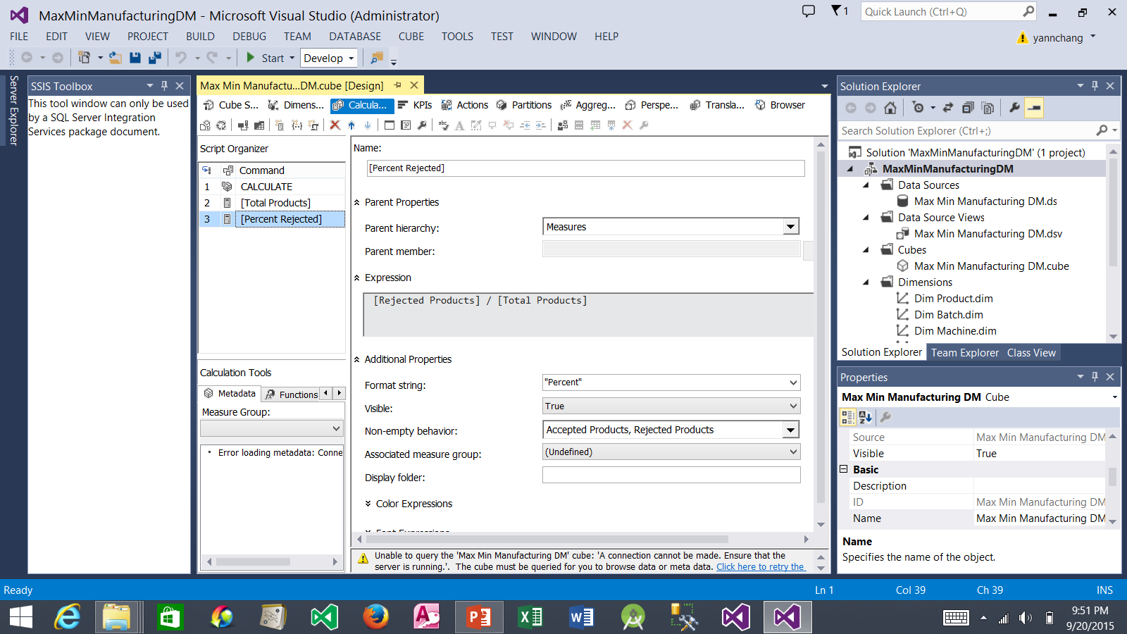
Working with Measures and Measure Groups (cont.)
6. Click the Save All button.
7. Click this X to close the Cube Design tab.
1. Click the New Calculated Member button.
2. Type as shown here.
3. Type as shown here.
4. Select Percent.
5. Click this drop-down list and check Accepted Products and Rejected Products options.

Slide 32
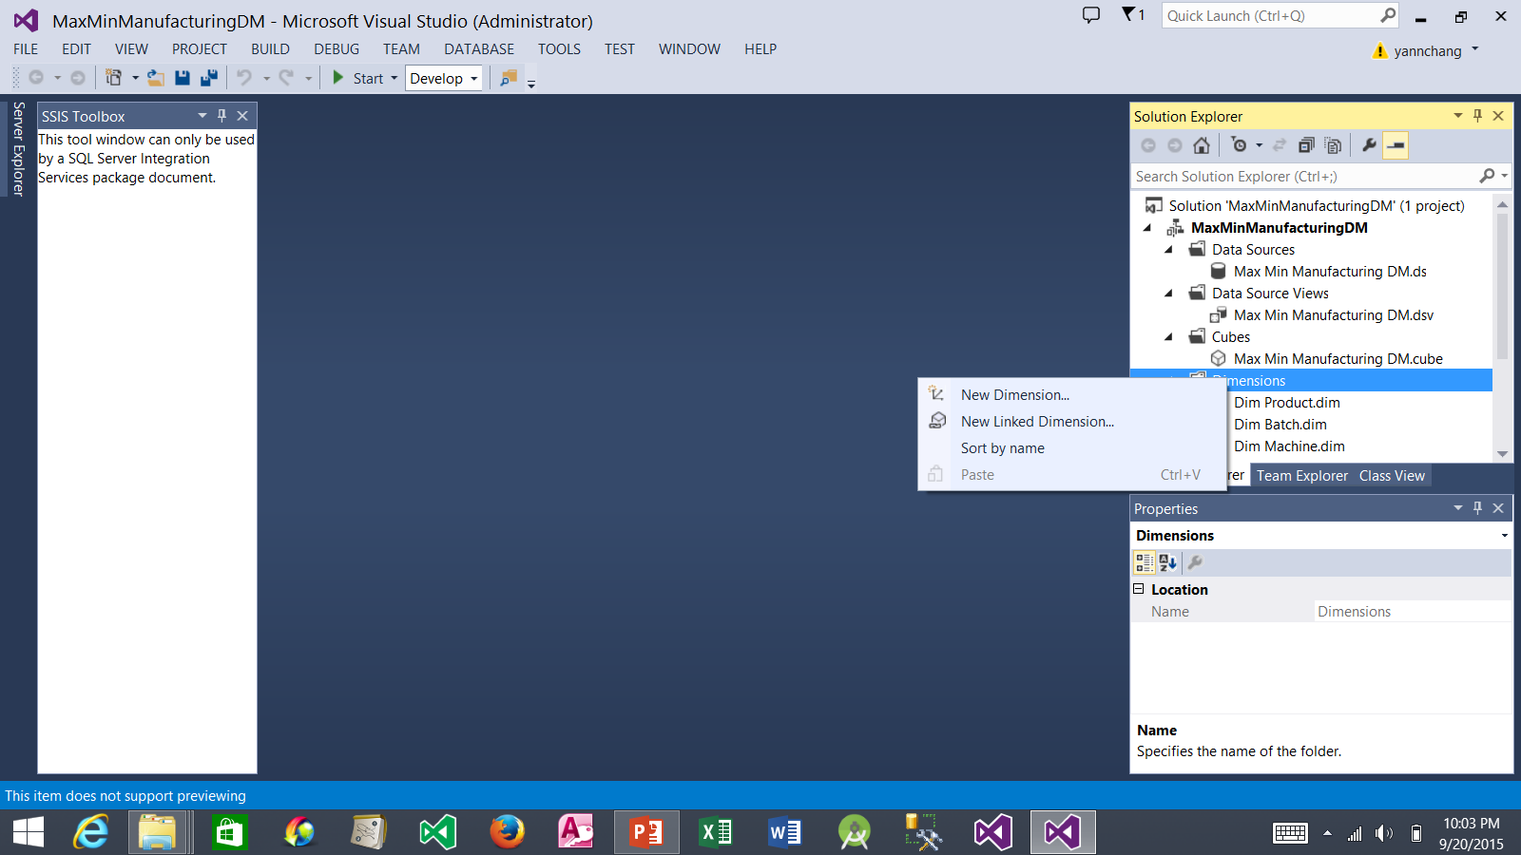
Creating a Time Dimension
1. Right-click the Dimensions folder.
2. Select New Dimension…

Slide 33
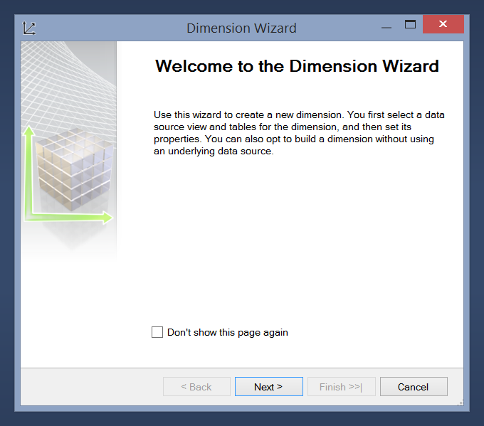
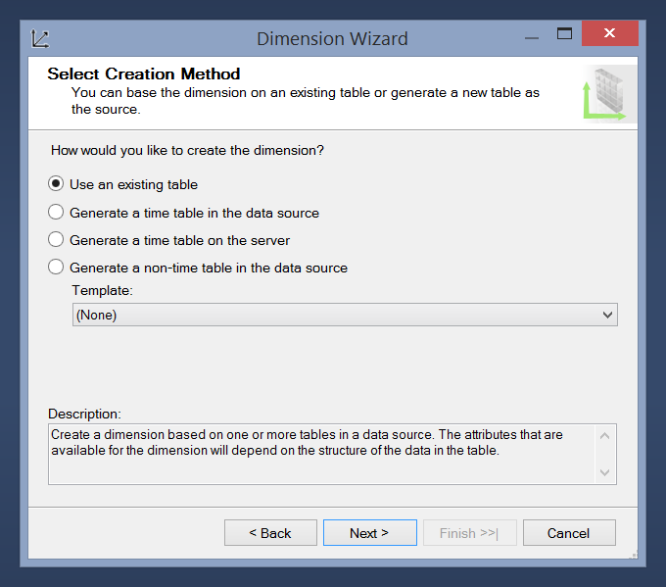
Creating a Time Dimension (continued)
2. Be sure this option is selected.
1. Click the Next button.
3. Click the Next button.

Slide 34
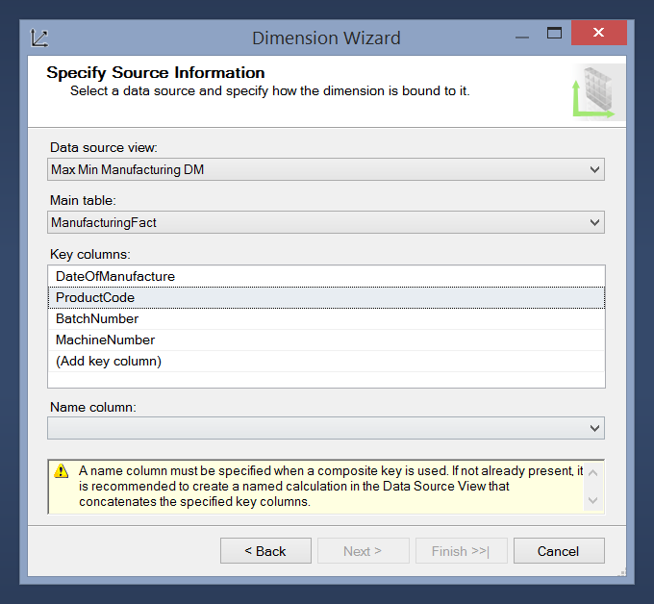
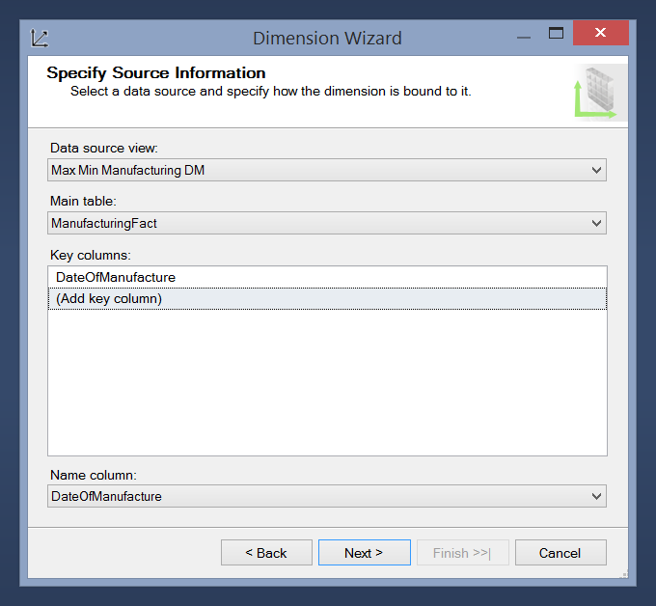
Creating a Time Dimension (continued)
1. Select ManufacturingFact. Although it is a fact table, it also contains the date information, which is needed for the time dimension.
3. After Step 2, the Key Columns list contains only DateOfManufacture.
4. Select DateOfManufacture.
2. Click the drop-down list of the ProductCode and then select the Blank entry from the list. Repeat the process for BatchNumber and MachineNumber.
5. Click the Next button.

Slide 35
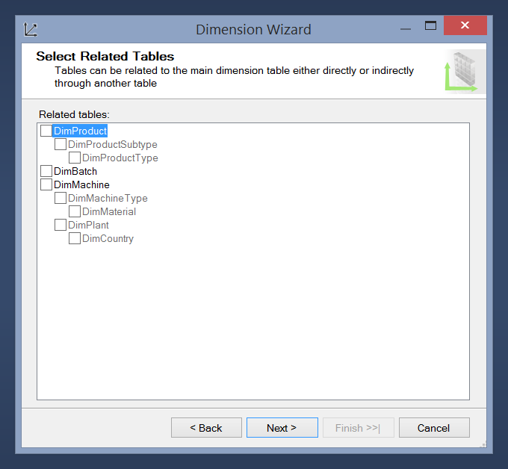
Creating a Time Dimension (continued)
1. Uncheck all options.
2. Click the Next button.

Slide 36
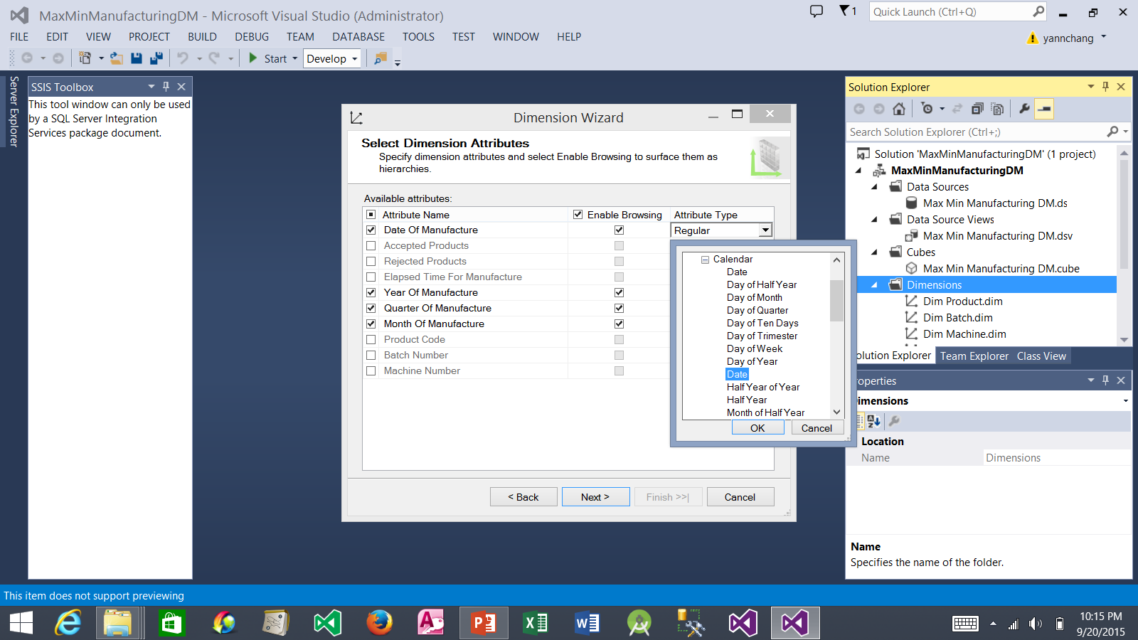
Creating a Time Dimension (continued)
2. Click the drop-down arrow, expand the Date entry, expand the Calendar entry, select Date and click OK.
1. Be sure to check only the four options as shown here.

Slide 37
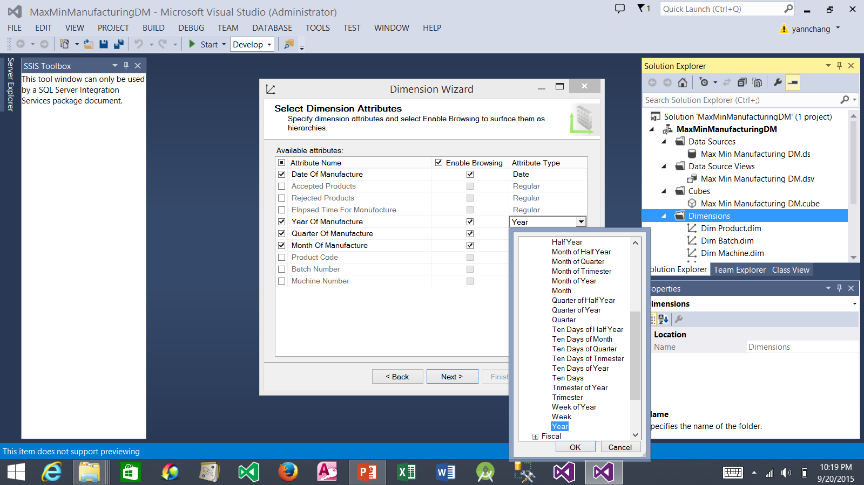
Creating a Time Dimension (continued)
1. Click the drop-down arrow, expand the Date entry, expand the Calendar entry, select Year and click OK.
2. Repeat Step 1 for Quarter Of Manufacture, selecting Quarter.
3. Repeat Step 1 for Month Of Manufacture, selecting Month.

Slide 38
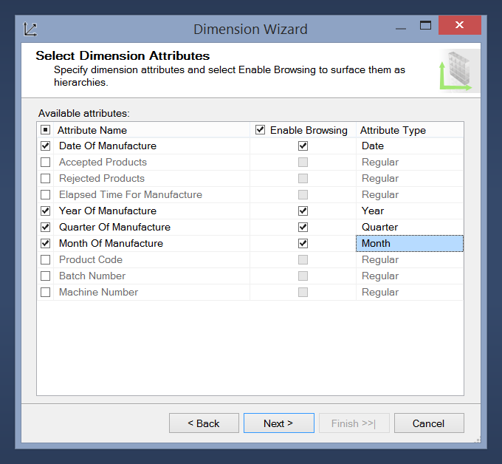
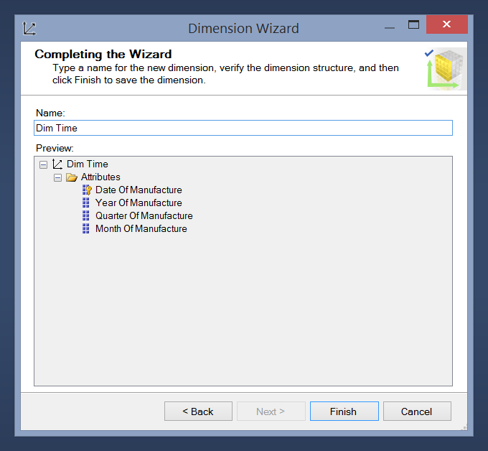
Creating a Time Dimension (continued)
3. Change the name to Dim Time.
1. After changing the four attribute types, the wizard should look as shown here.
4. Click the Finish button.
2. Click the Next button.

Slide 39
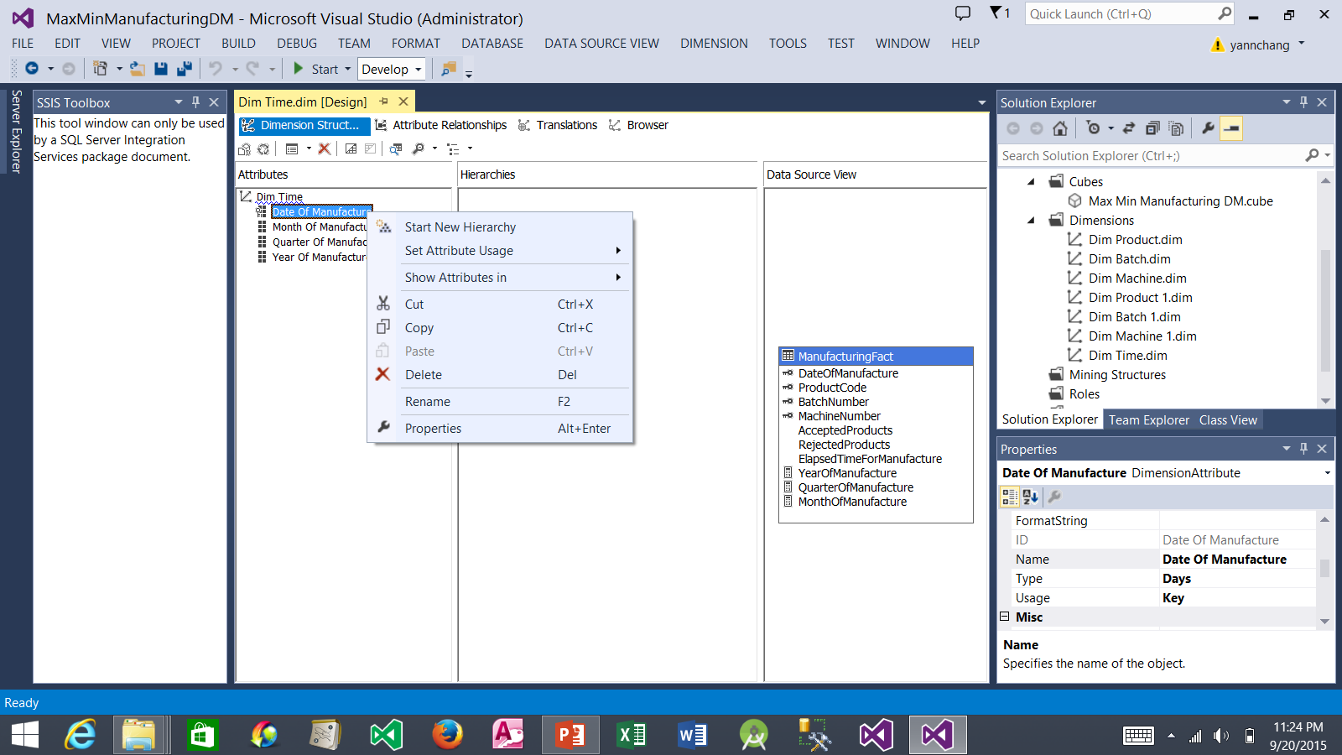
Creating a Time Dimension (continued)
1. Right-click Date Of Manufacture attribute and select Rename. Rename it to Date.
2. Repeat Step 1 three more times to rename Month Of Manufacture to Month, Quarter Of Manufacture to Quarter, and Year Of Manufacture to Year.

Slide 40
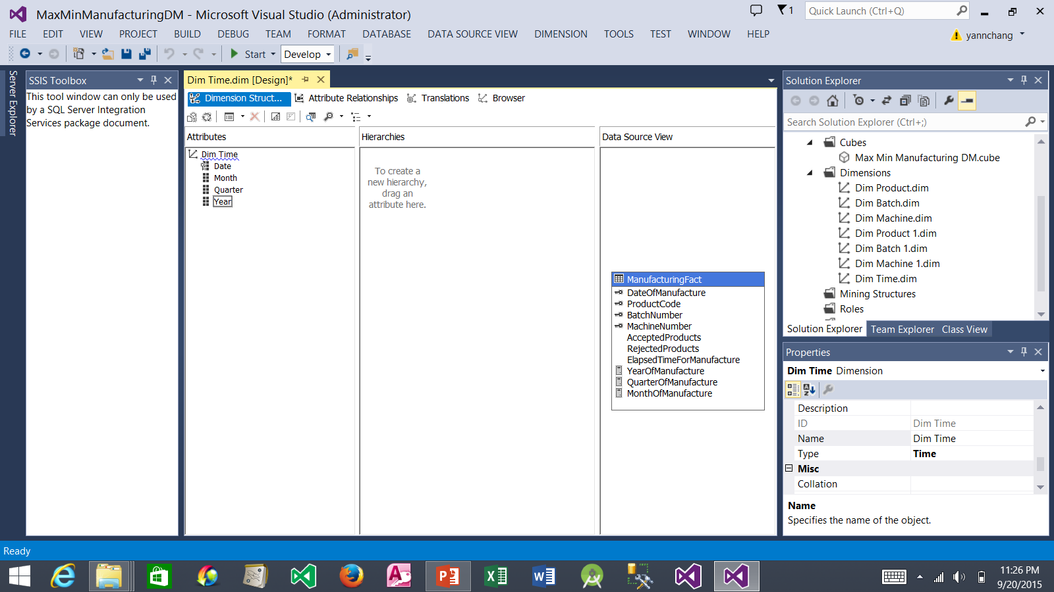
Creating a Time Dimension (continued)
1. After changing the attribute names, they should look as shown here.
2. Drag the Year attribute and drop it in the Hierarchies area.
3. Drag the Quarter attribute and drop it on <new level> in the Hierarchies area. Repeat this process for Month and Date attributes.

Slide 41
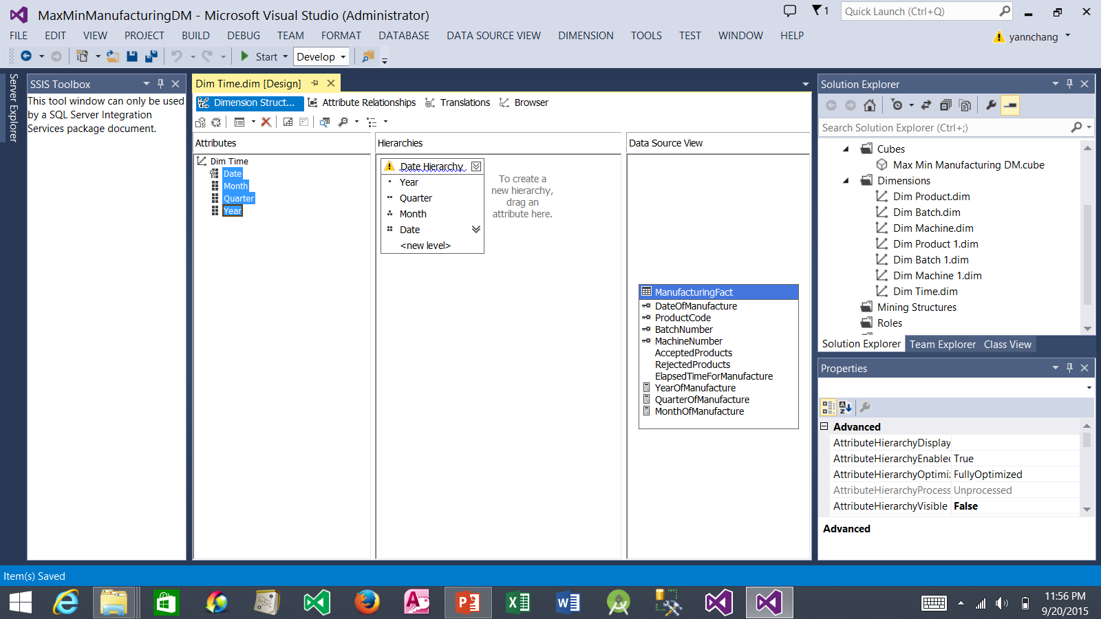
Creating a Time Dimension (continued)
1. Right-click the word “Hierarchy” and select Rename. Rename it to Date Hierarchy and press Enter.
2. Select all four attributes
3. Select False.

Slide 42
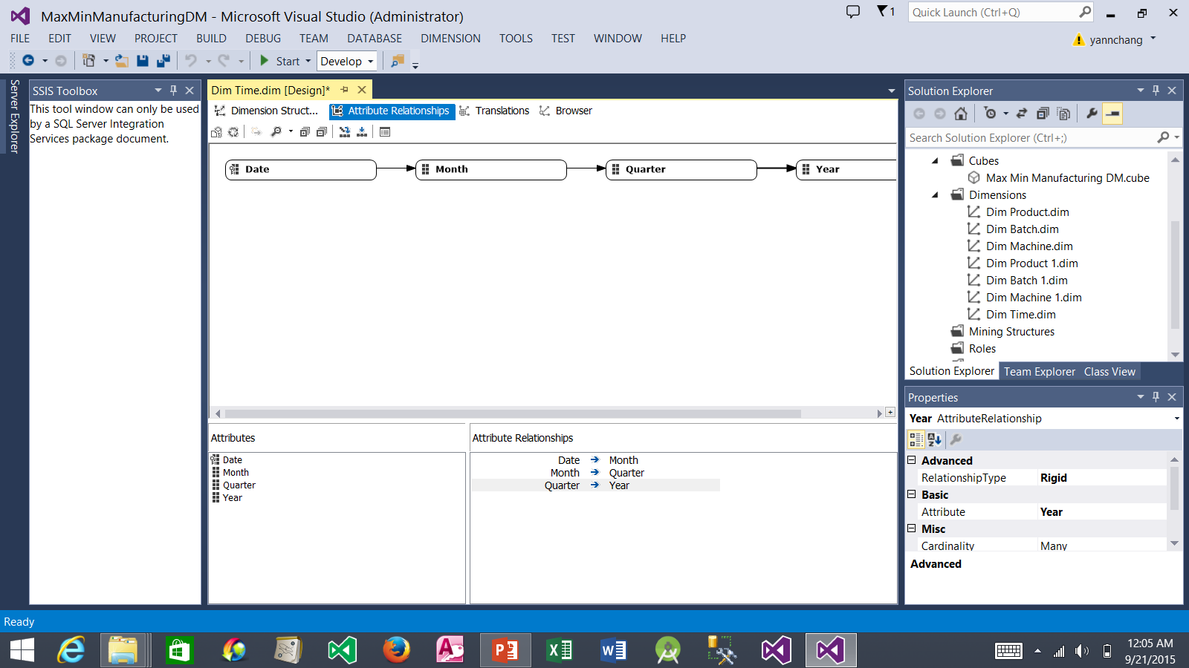
Creating a Time Dimension (continued)
5. Click this X to close the tab.
1. Click the Attribute Relationships tab.
4. Click the Save All button.
2. Set the relationships as shown here. To do it: (a) Drag the Month and drop it on the Quarter. (b) Drag the Quarter and drop it on the Year.
3. Right-click each of the three relationship arrows. Select Relationship Type | Rigid from the context menu.

Slide 43

Creating Hierarchies for Dim Machine Dimension
1. Double-click the Dim Machine dimension
2. The Dim Machine dimension tab appears.
3. We need to drag and drop attributes here to create two hierarchies. See next slide.

Slide 44

Creating Hierarchies for Dim Machine Dimension (cont.)
1. Create a new hierarchy as shown and name it Material Hierarchy.
2. Create a second hierarchy as shown and name it Plant Hierarchy.
3. Select all of these five attributes.
4. While the five attributes in Step 3 are selected, select False for this property.

Slide 45

Creating Hierarchies for Dim Machine Dimension (cont.)
5. Click this x to close the tab.
1. Select the Attribute Relationships tab.
2. Right-click one of the relationship arrow. Select Relationship Type and then select Rigid.
4. Click the Save All button.
3. Repeat Step 2 for the other three arrows.

Slide 46

Creating a Hierarchy for Dim Product Dimension
1. Create a new hierarchy as shown and name it Product Hierarchy.
2. Select all of these three attributes.
3. While the three attributes in Step 2 are selected, select False for this property.

Slide 47

Creating a Hierarchy for Dim Product Dimension (cont.)
5. Click this x to close the tab.
1. Select the Attribute Relationships tab.
2. Right-click one of the relationship arrow. Select Relationship Type and then select Rigid.
4. Click the Save All button.
3. Repeat Step 2 for the other arrow.

Slide 48

Relating Dimensions to Measure Groups
1. Double-click the Max Min Manufacturing DM Cube.
2. The Design tab appears.
3. Select the Dimension Usage tab.

Slide 49


Relating Dimensions to Measure Groups (continued)
4. Dim Time dimension should be added here.
2. Select Dim Time.
3. Click the OK button.
1. Right-click in an empty space and then select Add Cube Dimension…

Slide 50

Relating Dimensions to Measure Groups (continued)
1. Select this entry and then click the ellipsis (…). The Define Relationship window appears (see next slide).

Slide 51

Relating Dimensions to Measure Groups (continued)
1. Select Regular.
2. Select Date.
3. Select DateOfInventory
4. Click the OK button.

Slide 52

Relating Dimensions to Measure Groups (continued)
2. Click the Save All button.
1. Dim Time dimension and Inventory Fact measure group are now related.
3. At this point, we have cube definitions that exist as Extensible Markup Language (XML) definition documents. We need to deploy the cube to SQL Server Analysis Services Databases. Once we do this, we can begin querying aggregates from the cube.

Slide 53
Deploying and Processing Cubes
There are two steps before a cube become useful.
First, we need to deploy the structures to the Analysis Services database. This step moves project’s definition from the development environment to a server environment. In the development environment, only the developer has access to the objects in the project. In the server environment, those objects are exposed to any users with the appropriate access rights.
Second, at the end of the deployment process, the Analysis Services database is automatically created and processed. When the Analysis Services database is processed, it reads data from its data source. Dimensions are populated with members. Measures are populated with facts. Then the aggregate for all the combinations within the dimensional hierarchy are calculated. When the processing is complete, the Analysis Services database is ready for analysis to begin.

Slide 54

Deploying Cubes
1. Select PROJECT from the menu bar.
2. Select MaxMinManufacturingDM Properties... The Property Pages window should appear (see next slide).

Slide 55

Deploying Cubes (continued)
1. Select Deployment.
2. Enter YourComputerName\ SQLServerInstanceName.
3. Be sure that the database is MaxMinManufacturingDM.
4. Click the OK button.

Slide 56

Deploying Cubes (continued)
1. Select BUILD from the menu bar.
2. Select Deploy MaxMinManufacturingDM.
3. Provide the necessary credential to login to the SQL Server 2014 if prompted. After a short time, Deployment Completed Successfully message appears (see next slide).

Slide 57

Deploying Cubes (continued)
2. Click the Save All button.
3. Click this x to close the SQL Server Data Tools.
1. Successful deployment message appears after a short time.
4. To prove that the cube was deployed successfully, we need to use the SQL Server Management Studio to browse the cube in our newly created Analysis Services database. Open the SQL Server Management Studio (see next slide).

Slide 58

Browsing the Cube using SQL Server Management Studio
1. Launch the SQL Server Management Studio.
2. Select Analysis Services.
3. Enter YourComputerName\ SQLServerInstanceName
4. Click the Connect button.

Slide 59

Browsing the Cube using SQL Server Management Studio (cont.)
1. MaxMinManufcaturingDM database was created.
2. The Max Min Manufacturing DM cube was successfully deployed.
3. Enter YourComputerName\ SQLServerInstanceName

Slide 60

Browsing the Cube using SQL Server Management Studio (cont.)
1. Right-click Max Min Manufacturing DM cube.
2. Select Browse. A Browse window appears (see next slide).

Slide 61

Analyzing the Cube using SQL Server Management Studio
4. You should see Total Products = 10296577.
1. Expand the Measures node.
2. Drag the Total Products.
3. Drop it in this area.

Slide 62

Analyzing the Cube using SQL Server Management Studio (cont.)
1. Expand the Dim Product node and expand the Product Hierarchy.
4. You should see two columns as shown here.
2. Drag the Product Type Code.
3. Drop it in this area to the left of Total Products column.

Slide 63

Analyzing the Cube using SQL Server Management Studio (cont.)
3. Drop it between Product Type Code and Total Products columns.
1. Expand the Dim Time node and expand the Date Hierarchy.
4. You should see three columns as shown here.
2. Drag the Month.

Slide 64

Analyzing the Cube using SQL Server Management Studio (cont.)
2. Drop it between Product Type Code and Month columns.
3. You should see four columns as shown here.
4. In case you change your mind and want to remove the Month dimension, simply drag the Month heading off the query result until the mouse pointer includes an X and then release it. The Month dimension is then removed from the query.
1. Drag the Year dimension.
5. At this point, you have completed Tutorial 4.

